Slide 1




Encapsulation and Polymorphism
Encapsulation, Polymorphism, Class Hierarchies, Cohesion and Coupling
SoftUni Team
Technical Trainers
Software University
http://softuni.bg

Slide 2



Contents
Encapsulation
Polymorphism
Class Hierarchies: Real World Example
Cohesion and Coupling

Slide 3

Encapsulation

Slide 4
Encapsulation
Encapsulation hides the implementation details
Class announces only a few operations (methods) available for its clients – its public interface
All data members (fields) of a class should be hidden
Accessed via properties (read-only and read-write)
No interface members should be hidden
Encapsulation == hide (encapsulate) data behind constructors and properties

Slide 5
Encapsulation – Example
Data fields are private
Constructors and accessors are defined (getters and setters)
Person
-name : string
-age : int
+Person(string name, int age)
+Name : string { get; set; }
+Age : TimeSpan { get; set; }

Slide 6
Encapsulation in C#
Fields are always declared private
Accessed through properties in read-only or read-write mode
Properties perform checks to fight invalid data
Constructors are declared public
Constructors perform checks to keep the object state valid
Interface methods are always public
Not explicitly declared with public
Non-interface methods are declared private / protected

Slide 7
Encapsulation – Benefits
Ensures that structural changes remain local
Changing the class internals does not break any outside code
Allows changing the internal class implementation
Encapsulation allows adding logic when accessing object data
E.g. validations on when a property is modified
E.g. notifications about changes (allows data binding)
Hiding implementation details reduces complexity
Easier maintenance

Slide 8
Encapsulation – Example
public class Person
{
private string name;
public string Name
{
get { return this.name; }
set
{
if (value == null)
throw new ArgumentException("Invalid person name.");
this.name = value;
}
}
}
The field "name" is encapsulated (hidden)

Slide 9

Encapsulation
Live Demo
Notes:
(c) 2006 National Academy for Software Development - http://academy.devbg.org*
9##

Slide 10
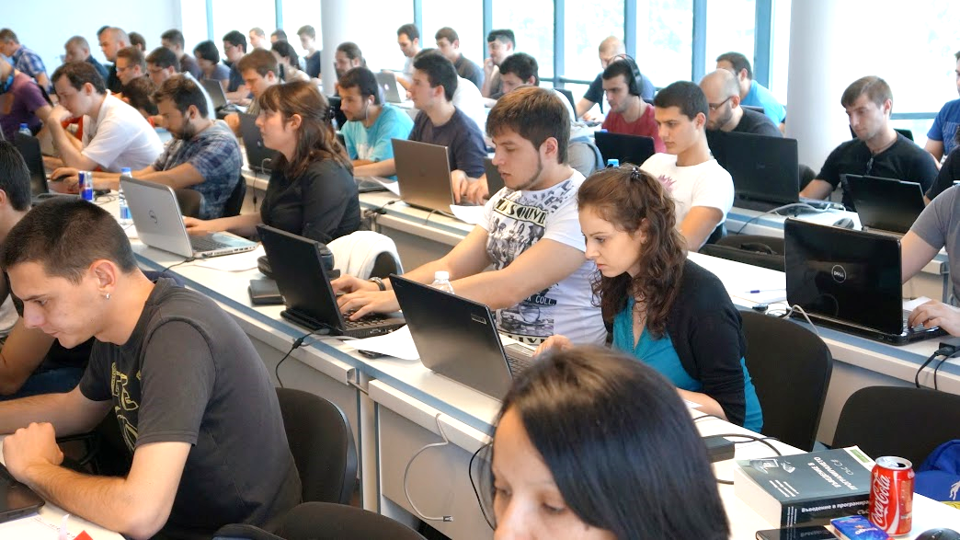
Exercise in Class

Slide 11
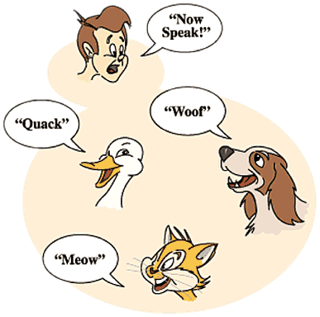
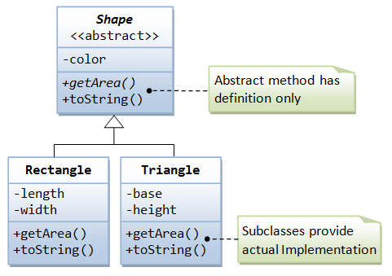
Polymorphism
Notes:
(c) 2006 National Academy for Software Development - http://academy.devbg.org*
11##

Slide 12
Polymorphism
Polymorphism = the ability to take more than one form (objects have more than one type)
A class can be used through its parent interface
A child class may override (change) some of the parent's methods
Polymorphism allows invoking abstract operations
Defined in the base class / interface
Implemented in the child classes
Declared as abstract or virtual or inside an interface

Slide 13
Polymorphism – Example
Abstract class
Figure
Abstract action
+CalcSurface() : double
Concrete class
Square
Circle
-x : int
-y : int
-size : int
-x : int
-y : int
-radius : int
Overriden action
Overriden action
+CalcSurface()
+CalcSurface()
public override double CalcSurface()
{
return size * size;
}
public override double CalcSurface()
{
return Math.PI * radius * raduis;
}

Slide 14
Polymorphism – Example (2)
abstract class Figure
{
public abstract double CalcSurface();
}
class Square
{ public override double CalcSurface() { return size * size; } }
class Circle
{ public override double CalcSurface() { return PI * r * r; } }
Figure f1 = new Square(…);
Figure f2 = new Circle(…);
double surface = f1.CalcSurface(); // Call Square.CalcSurface()
double surface = f2.CalcSurface(); // Call Circle.CalcSurface()

Slide 15
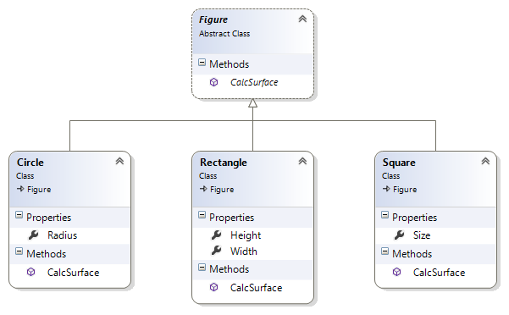
Polymorphism
Live Demo

Slide 16
Polymorphism – Why?
Why handle an object of given type as object of its base type?
To invoke abstract operations implemented in the child classes
To mix different data types in the same collection
E.g. List<Figure> can hold Circle and Rectangle objects
To pass more specific object to a method that expects a more generic type (e.g. SchoolStudent instead of Student)
To declare a more generic field which will be initialized and "specialized" later (in a subclass)

Slide 17
Virtual Methods
A virtual method is:
Defined in a base class and can be changed (overridden) in the descendant classes
Virtual methods are declared through the keyword virtual
Methods declared as virtual in a base class can be overridden using the keyword override
public virtual void Draw() { … }
public override void Draw() { … }

Slide 18
Virtual Methods – Example
abstract class Figure
{
public virtual void Draw()
{
Console.WriteLine(
"I am a figure of type: {0}", this.GetType().Name);
}
}
class Circle : Figure
{
public override void Draw()
{
Console.WriteLine("I am a circle");
}
}

Slide 19
Calling Base Virtual Methods – Example
class Circle : Figure
{
public override void Draw()
{
Console.WriteLine("I am a circle:");
Console.WriteLine(" --- ");
Console.WriteLine("| |");
Console.WriteLine(" --- ");
}
}
class SpecialCircle : Circle
{
public override void Draw()
{
Console.WriteLine("I am a special circle.");
base.Draw();
}
}

Slide 20

Virtual Methods
Live Demo

Slide 21
More about Virtual Methods
Abstract methods are purely virtual
If a method is abstract → it is virtual as well
Abstract methods are designed to be changed (overridden) later
Interface members are also purely virtual (abstract)
They have no default implementation and are designed to be overridden in descendant classes
Virtual methods can be hidden through the new keyword:
public new double CalculateSurface() { return … }

Slide 22

The override Modifier
Use override to modify a method or property
Provide a replacement implementation for the inherited member
You cannot override a non-virtual or static method
The overridden base method must be one of the following:
virtual
abstract
override
(interface method)

Slide 23
Polymorphism – How It Works?
Polymorphism ensures that the appropriate method of the subclass is called through its base class' interface
In C++, C#, Java polymorphism is implemented using a technique called "late binding"
The exact method to be called is determined at runtime
Just before performing the call
Applied for all abstract / virtual methods
Note: late binding is a bit slower than normal (early) binding

Slide 24
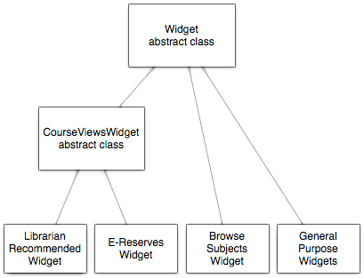
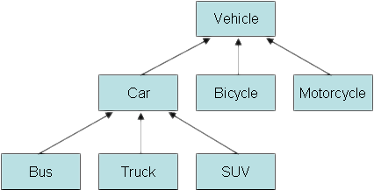
Class Hierarchies: Real World Examples
Notes:
(c) 2006 National Academy for Software Development - http://academy.devbg.org*
24##

Slide 25
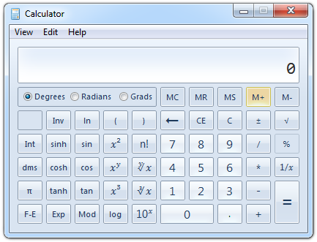
Real World Example: Calculator
Creating an application like the Windows Calculator
Typical scenario for applying the object-oriented approach

Slide 26
Real World Example: Calculator (2)
The calculator consists of controls:
Buttons, text boxes, menus, check boxes, panels, etc.
Class Control – the root of our OO hierarchy
All controls can be painted on the screen
Should implement an interface IPaintable with a method Paint(surface)
Common control properties:
Location, size, text, face color, font, background color, etc.

Slide 27
Real World Example: Calculator (3)
Some controls could contain other (nested) controls inside
E.g. panels and toolbars can hold other controls
Class Container – extends Control, holds a list of child controls
The Calculator itself is a Form
Form is a special kind of Container
Forms hold also border, title, icon and system buttons
The form title is the text derived from Control
How does Calculator paint itself?
Invokes Paint() for all child controls inside it

Slide 28
Real World Example: Calculator (4)
How does a Container paint itself?
Invokes Paint() for all controls inside it (chain of responsibility)
Each control knows how to visualize (paint) itself
Buttons, check boxes and radio buttons are similar
Can be pressed
Can be focused
All buttons could derive from a common parent class AbstractButton

Slide 29
Calculator Classes
«interface»
IPaintable
Paint()
Control
-location
-size
-text
-bgColor
-faceColor
-font
Container
AbstractButton
TextBox
MainMenu
MenuItem
Panel
Form
Button
CheckBox
RadioButton
Calculator

Slide 30
Exercise in Class

Slide 31
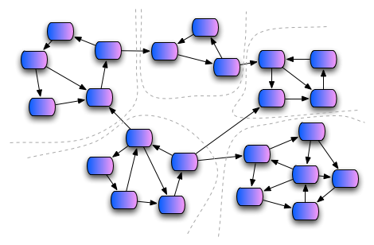
Cohesion and Coupling

Slide 32
Cohesion
Cohesion describes
How closely the routines in a class or the code in a routine support a central purpose
Cohesion must be strong
Well-defined abstractions keep cohesion strong
Classes must contain strongly related functionality and aim for single purpose
Cohesion is a powerful tool for managing complexity

Slide 33



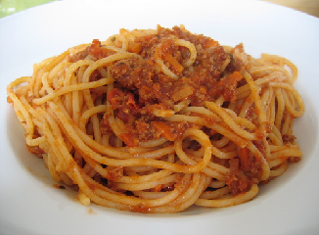
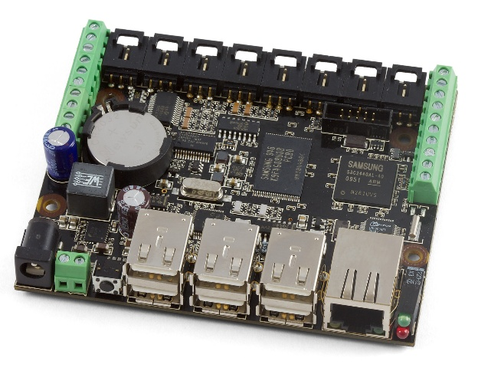
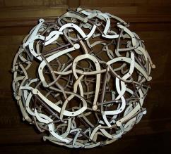
Good and Bad Cohesion
Good cohesion: HDD, CR-ROM, remote control
Bad cohesion: spaghetti code, single-board computer

Slide 34
Strong Cohesion
Strong cohesion (good cohesion) example:
Class Math that has methods:
Sin(), Cos(), Asin(), Sqrt(), Pow(), Exp(), Math.PI, Math.E
double sideA = 40, sideB = 69;
double angleAB = Math.PI / 3;
double sideC = sideA * sideA + sideB * sideB –
2 * sideA * sideB * Math.Cos(angleAB);
double sidesSqrtSum =
Math.Sqrt(sideA) + Math.Sqrt(sideB) + Math.Sqrt(sideC);

Slide 35
Weak Cohesion
Weak cohesion (bad cohesion) example
Class Magic that has these methods:
Another example:
public void PrintDocument(Document d);
public void SendEmail(
string recipient, string subject, string text);
public void CalculateDistanceBetweenPoints(
int x1, int y1, int x2, int y2)
MagicClass.MakePizza("Fat Pepperoni");
MagicClass.WithdrawMoney("999e6");
MagicClass.OpenDBConnection();

Slide 36
Coupling
Coupling describes how tightly a class or a routine is related to other classes or routines
Coupling must be kept loose
Modules must depend little on each other
Or be entirely independent (loosely coupled)
All classes / routines must have small, direct, visible, and flexible relationships to other classes / routines
One module must be easily used by other modules

Slide 37
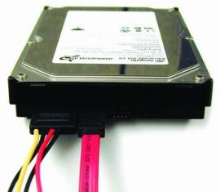
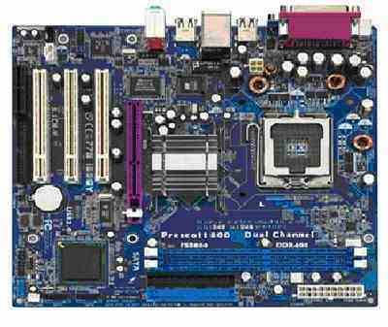
Loose and Tight Coupling
Loose coupling:
Easily replace old HDD
Easily place this HDD to another motherboard
Tight coupling:
Where is the video card?
Can you change the audio controller?

Slide 38
Loose Coupling – Example
class Report : IReport
{
public bool LoadFromFile(string fileName) {…}
public bool SaveToFile(string fileName) {…}
}
class Printer
{
public static int Print(IReport report) {…}
}
class Program
{
static void Main()
{
Report myReport = new Report();
myReport.LoadFromFile(@"C:\Reports\DailyReport.xml");
Printer.Print(myReport);
}
}

Slide 39
Tight Coupling – Example
class MathParams
{
public static double operand;
public static double result;
}
class MathUtil
{
public static void Sqrt()
{
MathParams.result = CalcSqrt(MathParams.operand);
}
}
class MainClass
{
static void Main()
{
MathParams.operand = 64;
MathUtil.Sqrt();
Console.WriteLine(MathParams.result);
}
}

Slide 40
Spaghetti Code
Combination of bad cohesion and tight coupling:
class Report
{
public void Print() {…}
public void InitPrinter() {…}
public void LoadPrinterDriver(string fileName) {…}
public bool SaveReport(string fileName) {…}
public void SetPrinter(string printer) {…}
}
class Printer
{
public void SetFileName() {…}
public static bool LoadReport() {…}
public static bool CheckReport() {…}
}

Slide 41
Exercise in Class

Slide 42

Summary
Encapsulation hides internal data
Access through constructors and properties
Keeps the object state valid
Polymorphism == using objects through their parent interface
Allows invoking abstract actions overridden in a child class
Strong cohesion == single purpose
Loose coupling == minimal interaction with others

Slide 43









OOP – Encapsulation and Polymorphism
https://softuni.bg/courses/oop/

Slide 44

License
This course (slides, examples, demos, videos, homework, etc.) is licensed under the "Creative Commons Attribution-NonCommercial-ShareAlike 4.0 International" license
Attribution: this work may contain portions from
"Fundamentals of Computer Programming with C#" book by Svetlin Nakov & Co. under CC-BY-SA license
"OOP" course by Telerik Academy under CC-BY-NC-SA license

Slide 45





Free Trainings @ Software University
Software University Foundation – softuni.org
Software University – High-Quality Education, Profession and Job for Software Developers
softuni.bg
Software University @ Facebook
facebook.com/SoftwareUniversity
Software University @ YouTube
youtube.com/SoftwareUniversity
Software University Forums – forum.softuni.bg

